Slide 1
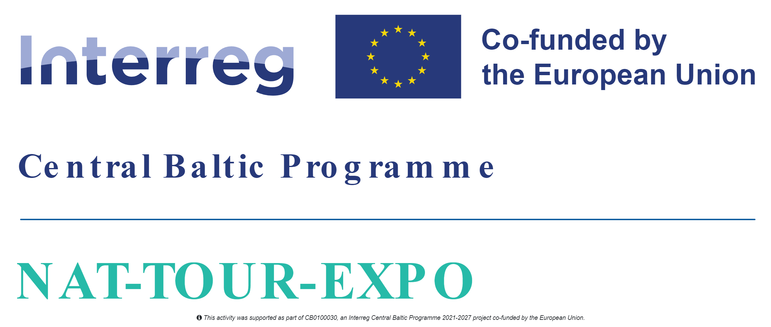
Exporting Baltic Nature Tourism to UK
(NAT-TOUR-EXPO)
Project partner meeting, 27th March 2025, Garkalne, Latvia

Slide 2


Programme reporting periods and logos
4th period project report is being made, control ongoing for LP 4th period project partner report. Afterwards the consolidated project report will be submitted.
5th project reporting period, 01.01.2025.-30.06.2025.
10 work days to submit the partner reports.
List of participants template –
https://centralbaltic.eu/wp-content/uploads/2023/05/List-of-participants.xlsx
Logos + Interreg Brand Design Manual 2021 - 2027
https://centralbaltic.eu/programme-logos/

Slide 3
Planned project activities
WP1
A 1.1, Matching the nature and tourist service potential with the UK market needs
A 1.2, Training support to SMES for product development and improvement
A 1.3, Best practice study trip for SMES - nature tourism product providers
A 1.4, Nature tourism product development
A 1.5, Visual identity and web design for presentation of the nature tourism product
A 1.6, Estonian-Latvian nature tourism product promo materials – not allowed, only printing!
A 1.7, National dissemination events
A 1.8, Nature tourism web platform
A 1.9, Project communication to SME target audience
WP2
A 2.1, Estonian-Latvian nature tourism product presentation at specialised travel trade events
A 2.2, FAM trips for UK tour operators, travel companies and media
A 2.3, Estonian-Latvian nature tourism product presentation at travel markets
A 2.4, Estonian-Latvian nature tourism product presentation to nature organisations in the UK
A 2.5, Sales calls to specialised companies in UK
A 2.6, Digital marketing
A 2.7, E-newsletters and press releases
A 2.8, Review of other sales and marketing platforms
A 2.9, Project communication to general public
Activities completed

Slide 4
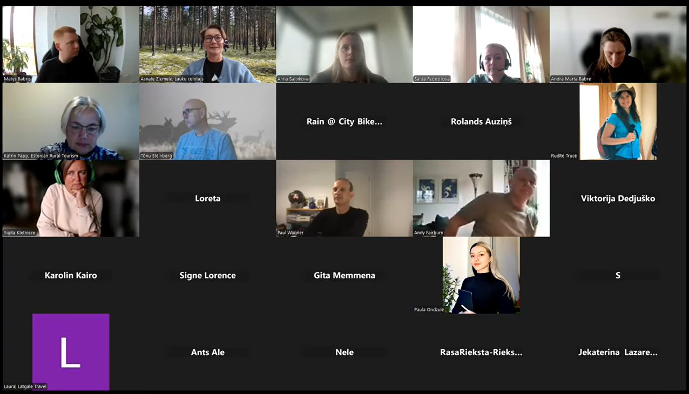
Activity 1.2
Training support to SMES for product development and improvement
On October 31, the Baltic Nature Tourism Project organized an online seminar to discuss the latest achievements in Baltic nature tourism.
The online seminar began with an address by representatives of the Baltic Nature Tourism Project, providing an overview of project activities, including the latest statistics and updates on the project’s impact and growth. Following this, Andy Fairburn and Paul Wagner from the Nordic Tourism Collective shared valuable insights into the UK market. They highlighted new tourism trends and the needs of UK travelers, emphasizing opportunities for the Baltic region, especially Latvia and Estonia, to attract greater interest from this market. The seminar concluded with a session led by Santa Feodorova from Baltic Travel Group and Valdis Čeics from Baltic Nature Travel, focused on creating engaging tourism offerings. Their discussion explored strategies for developing attractive and in-demand travel packages that best promote the export of nature tourism products.
LC webpage news article – https://www.celotajs.lv/en/news/item/view/1353
Seminar recording on youtube - https://youtu.be/m-XSbQjiVD0?si=RkYYbYZ4O44lUJP1

Slide 5
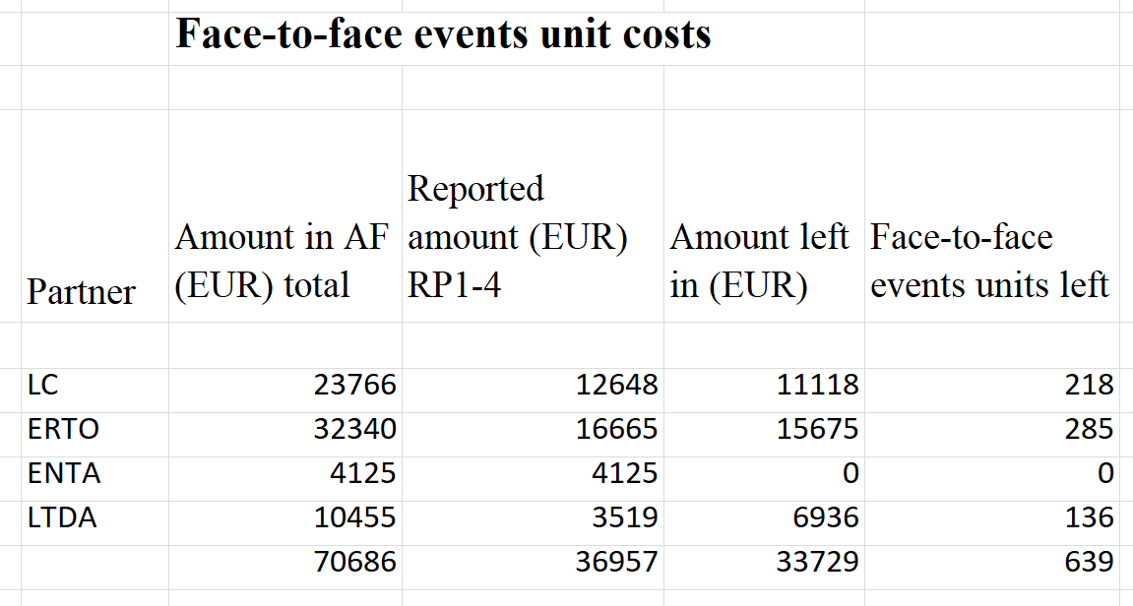
Activity 1.2
Face-to-face events
Have the 10 training events been organized?
If they are all organized and there are face-to-face event unit costs left, then it is possible to transfer them and organize other face-to-face events.

Slide 6
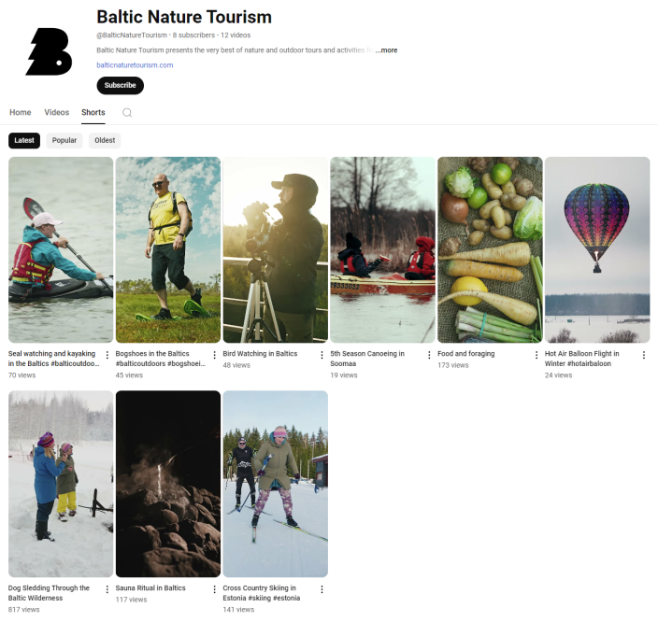
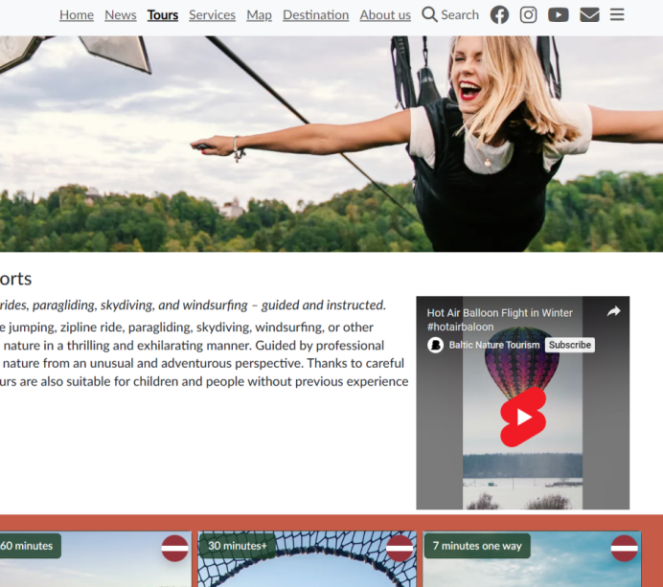
Activity 1.4
Nature tourism product development
There are 205 products in total published online provided by 44 EST SMEs and 54 LV SMEs (total 98 SMEs). Last updated for mid-term meeting.
Filming of the short promotional video reels has been finalized. In total 10 reels have been developed. Bogshoe hiking, seal watching/kayaking and accommodations, food and foraging were the 3 final developed reels. They can be viewed in the https://balticnaturetourism.com website and the projects youtube channel.
https://www.youtube.com/@BalticNatureTourism
All reels can be downloaded from here - https://files.fm/u/3s9u5awenk

Slide 7
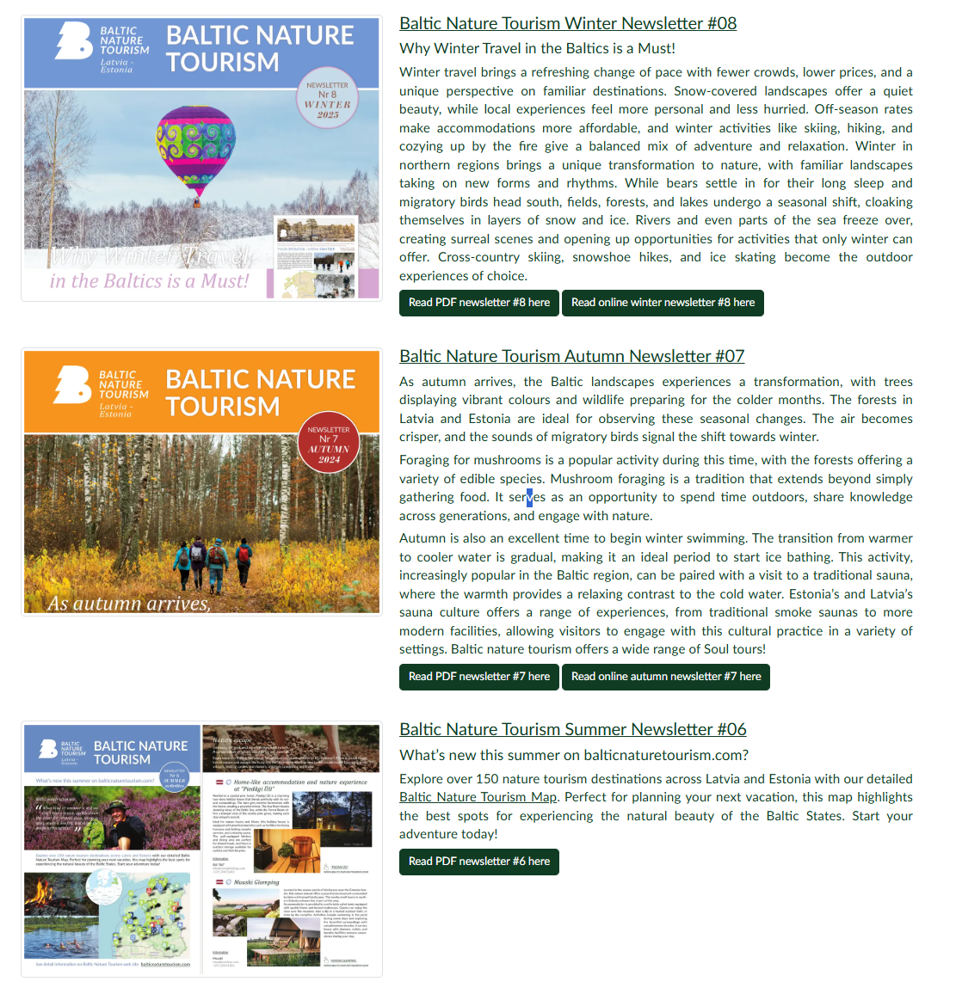
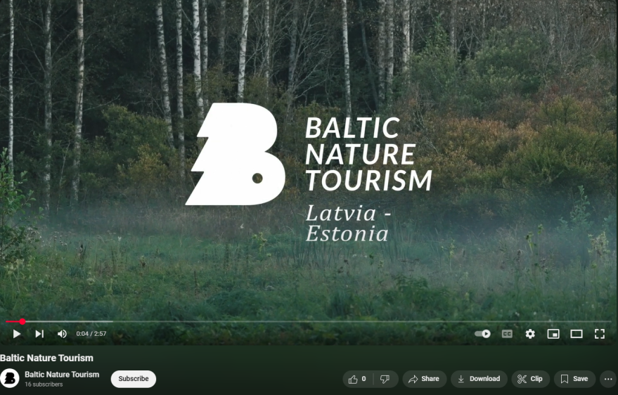
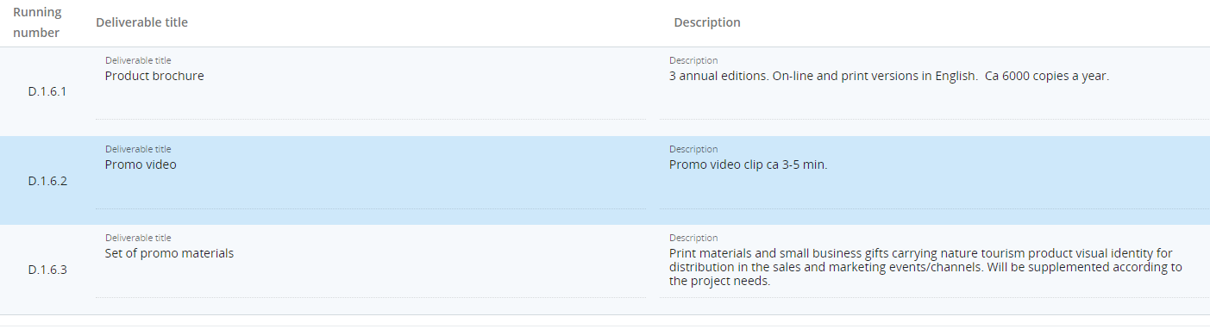
Activity 1.6
Estonian-Latvian nature tourism product promo materials
Continuing the good practice - the Summer #06, the Autumn #07 and the Winter #08 newsletters were all printed in 500 copies for marketing purposes to be distributed at events.
The professional quality 3min long promotional BNT video was finalized during the period, it features the nature values and product experiences.
https://youtu.be/ekoqkeI2CXk?si=2UKvrx84Oho6srt6
During the period, LC printed 500 copies of small promo info leaflets/cards carrying nature tourism product visual identity for distribution in the sales and marketing events/channels.
Small info cards in 100 copies were printed for promotion of the upcoming FAM trip during the London Embassy event on 12.12.2024.

Slide 8
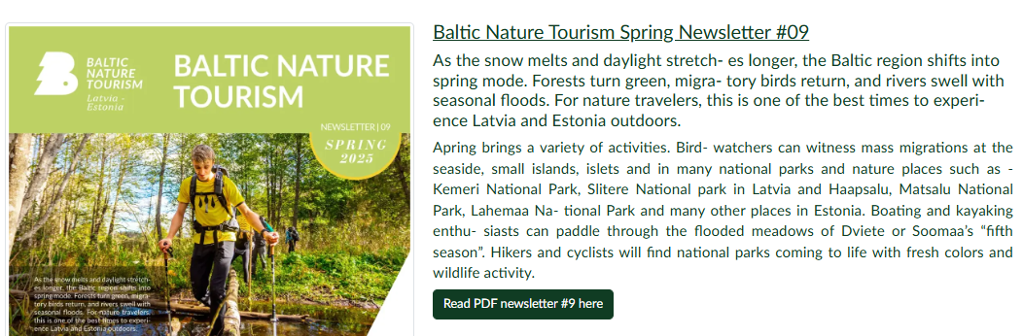
New SPRING 2025 newsletter #09
New SPRING 2025 newsletter #09 has been prepared. Will be printed in April.
https://balticnaturetourism.com/g/www/cms/c00003/Baltic-Nature-Tourism-Newsletter-Nr-9.pdf

Slide 9
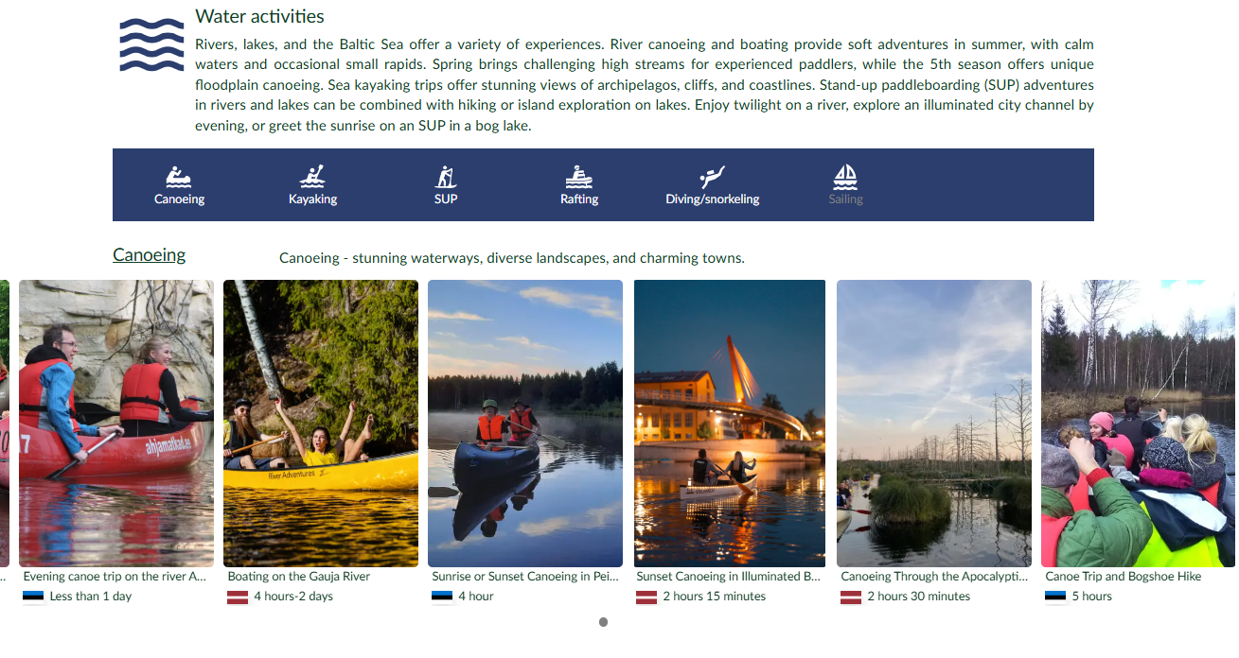
Activity 1.8
Nature tourism web platform https://balticnaturetourism.com
Over the past six months, the project website has been visited by more than 7,100 unique visitors.
A very good observation is that the UK is in first place among all countries when grouping active users by country. Almost every 5th page visitor is from the UK.
Google organic search and direct links are the two main ways visitors reach the project website.

Slide 10
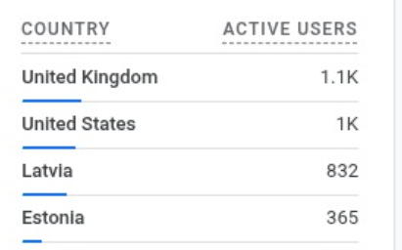
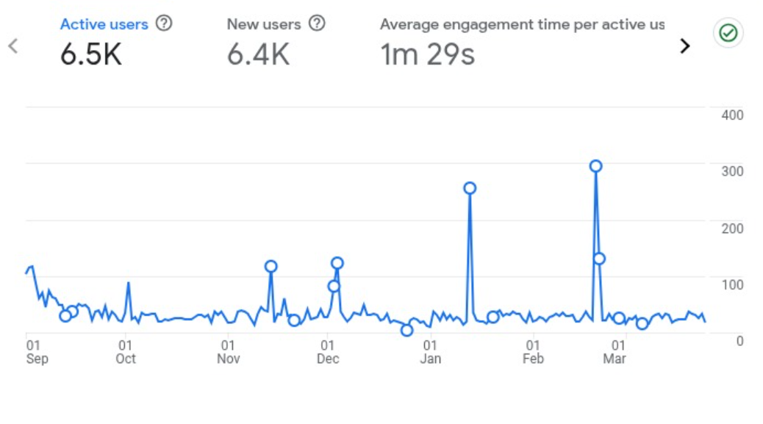
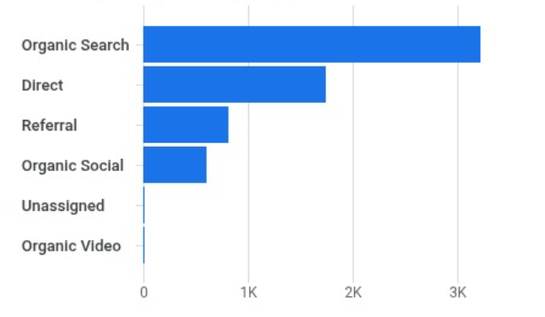
Nature tourism web platform
Statistics since last meeting (since 09.2024.)
Total web page users
Users by country
How the web page was reached
Users by device and browser

Slide 11
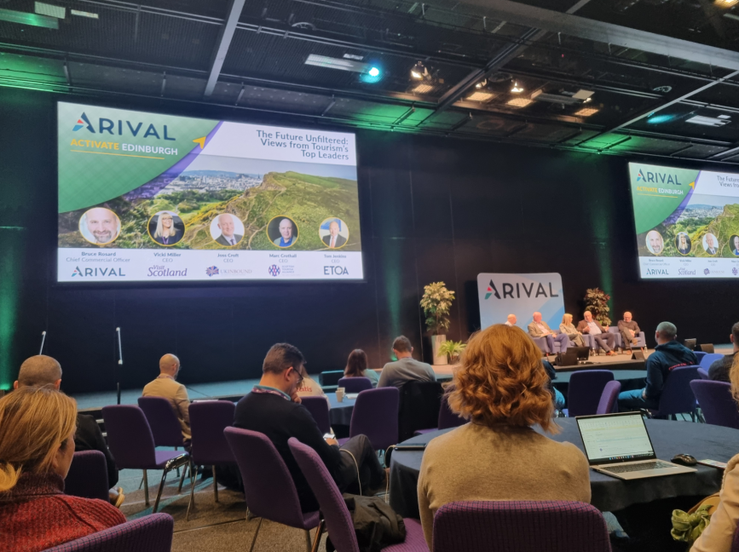
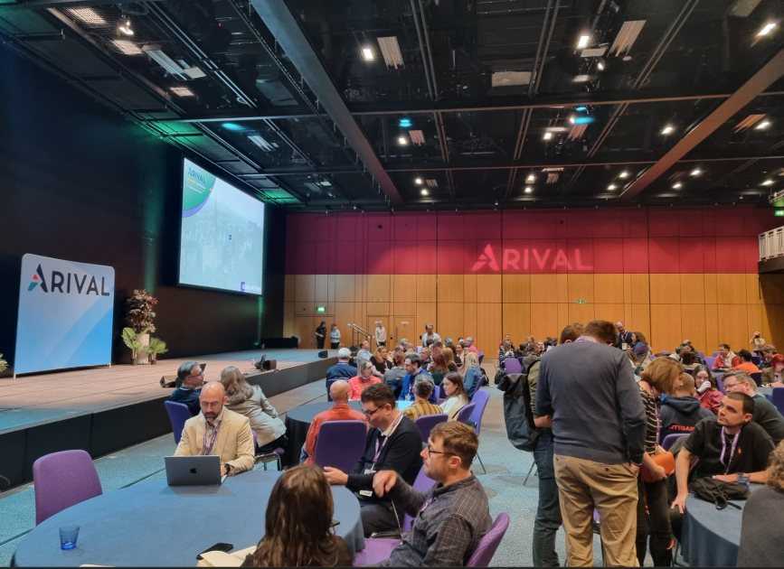
Activity 2.1
Estonian-Latvian nature tourism product presentation at specialised travel trade events
Arival | Activate Edinburgh, 24.11.2024.
The event was held at the Edinburgh International Conference Centre with experiential sessions and activities happening throughout the city of Edinburgh. With its focus on the Northern Europe regional market, it attracts the best from across the industry. Able to meet growth-minded peers in tours and attractions, innovative tech companies, DMOs, and major distributors who could hold the key to exponential growth for your business.
https://arival.travel/event/2024-edinburgh/

Slide 12
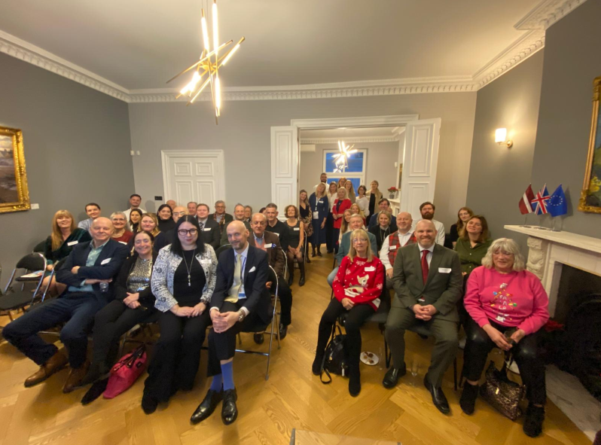
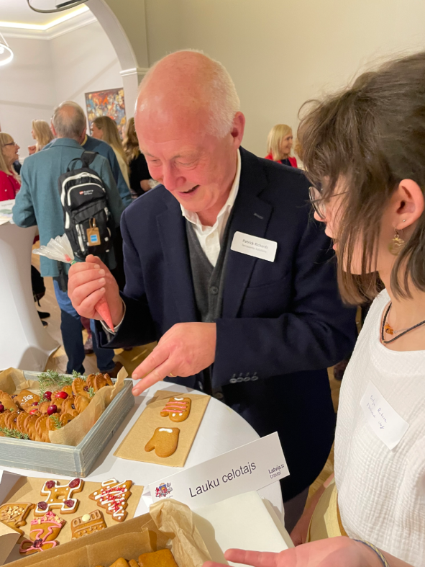
Activity 2.1
Estonian-Latvian nature tourism product presentation at specialised travel trade events
12.12. Christmas reception at the Latvian Embassy in London.
We participated in the LIAA Christmas spirit event in London, at the Embassy of the Republic of Latvia in the United Kingdom of Great Britain and Northern Ireland. The event brought together more than 40 tour operators and media representatives, to whom we presented the Latvian tourism offer, especially emphasizing the nature tourism opportunities of Baltic Nature Tourism in the winter season. We brought the Latvian Christmas spirit to London together with gingerbread baked by the Rubeņi family and blackcurrant-aronia mulled wine from the Abuls cider house.

Slide 13
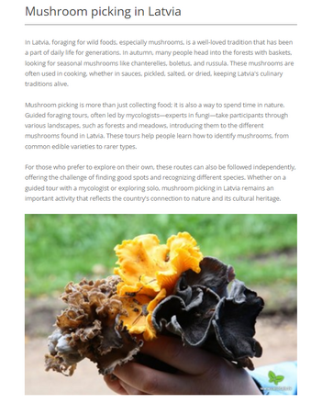
Activity 2.1
Estonian-Latvian nature tourism product presentation at specialised travel trade events
Online training course Baltic Nature Tourism on Equator Global portal. January 2025.
The online learning course titled Baltic Nature Tourism and Sustainability at the Equator Global https://www.equator.global/ provided an in-depth overview of nature tourism in the Baltic region, focusing on sustainable practices and the cultural and natural diversity of Latvia and its neighboring countries. It covered topics such as wildlife observation, eco-friendly accommodations, foraging traditions, and adventure activities, emphasizing low-impact tourism and conservation.
The course was attended by 123 participants, primarily from the United Kingdom (119), with additional attendees from Ireland (3) and the Channel Islands (1). Feedback was collected from 14 respondents, who rated the course highly, with 85.7% considering it excellent and 100% finding the quizzes enjoyable. Respondents highlighted the user-friendly platform and well-structured content, noting that the course effectively enhanced their understanding of the region’s tourism opportunities and its potential for meaningful travel experiences. The training course was developed by Latvian Nature Tourism team and published in cooperation with Latvian Development Agency (LIAA).

Slide 14
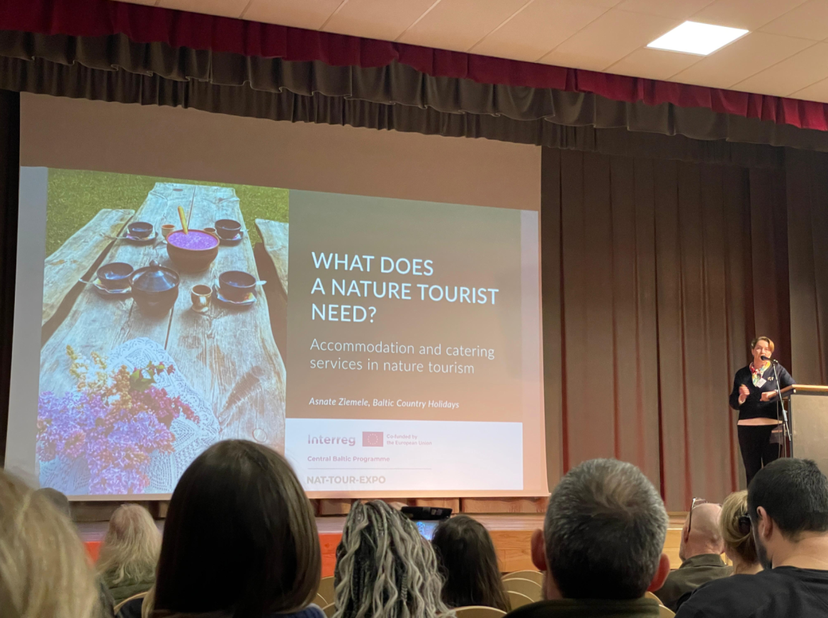
Activity 2.1
Estonian-Latvian nature tourism product presentation at specialised travel trade events
Sustainable Tourism Event to Gather Industry Leaders in Ķemeri National Park, February 11
On February 11, Ķemeri National Park hosted an international Sustainable Tourism event, bringing together approximately 100 participants from Latvia, Estonia, and Sweden. The event gatheredtourism professionals, municipal representatives, and state institutions working on tourism development in Protected Areas.
The program featured four parallel workshops, each focusing on key challenges and opportunities in sustainable tourism within Protected Areas. Experts from three countries presented case studies, followed by group discussions aimed at identifying challenges and best practices for future collaboration. The workshops concluded with a joint session to summarize key insights.

Slide 15
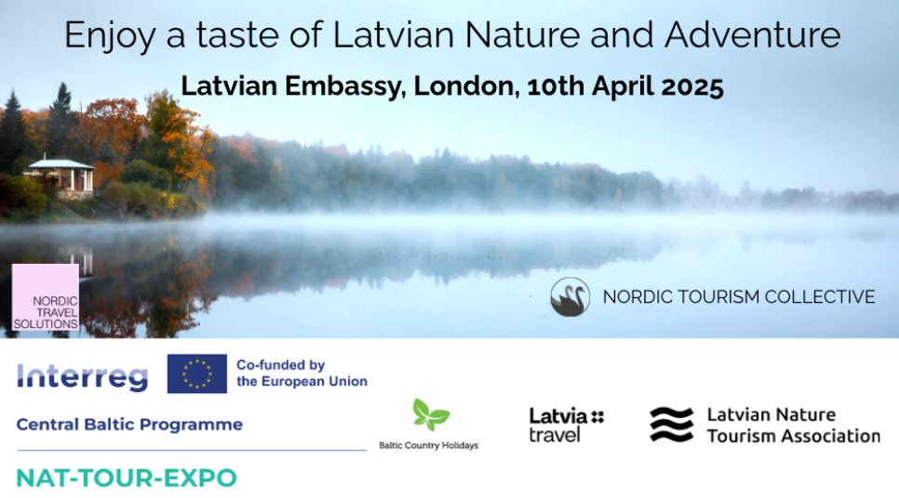
Activity 2.1
Estonian-Latvian nature tourism product presentation at specialised travel trade events
10th April, Latvia Embassy Reception: A Taste of Latvian Nature and Adventure.
On April 10, 2025, the Embassy of Latvia in the UK will host "A Taste of Latvian Nature and Adventure," an event highlighting Latvia’s nature tourism opportunities. Organized as part of the Baltic Nature Tourism project, the event will introduce Latvian tourism businesses and their outdoor experiences.
The program includes a welcome by Ambassador Atis Lots, an overview of Baltic Nature Tourism, and an interactive session on outdoor activities in Latvia. Chef Ēriks Dreibants will present a selection of food prepared from locally sourced ingredients. The event will also facilitate networking and B2B meetings with Latvian tourism businesses.

Slide 16
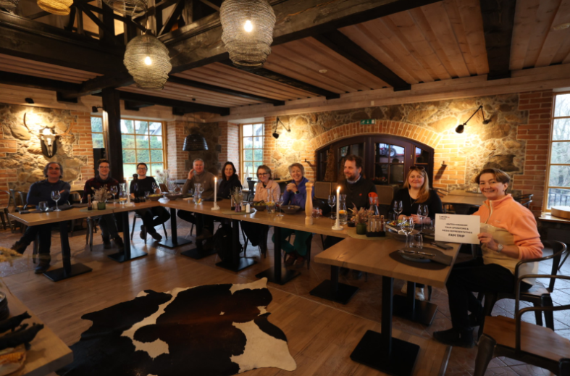
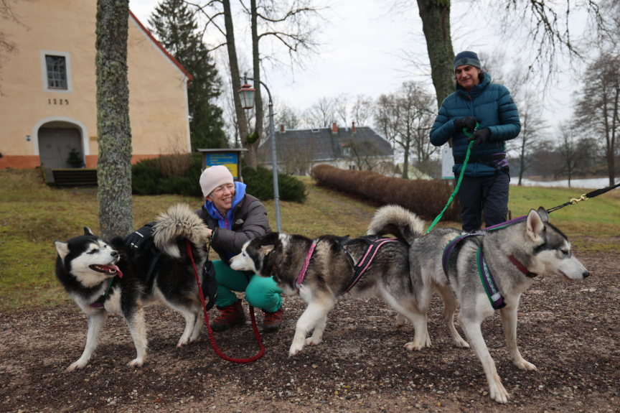
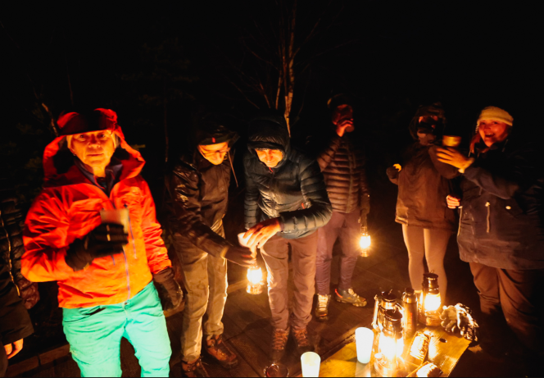
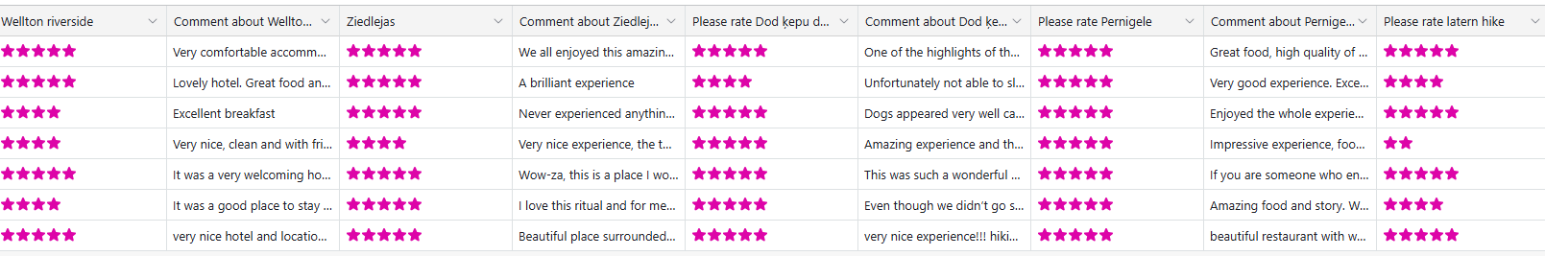
Activity 2.2
FAM trips for UK tour operators, travel companies and media
Tour operators and media representatives from the United Kingdom visited Latvia and Estonia as part of a FAM tour from January 28th to 31st.
https://www.celotajs.lv/en/news/item/view/1386
Feedback – 1) https://airtable.com/appMVwhk6wVorBgXB/shrrZvkOAa4mTR6hv/tblVf7t2OGQ9O74i5
2) https://airtable.com/appMVwhk6wVorBgXB/shrptB5w18pboCAZ1/tblf8BkwdS0tz1s66

Slide 17
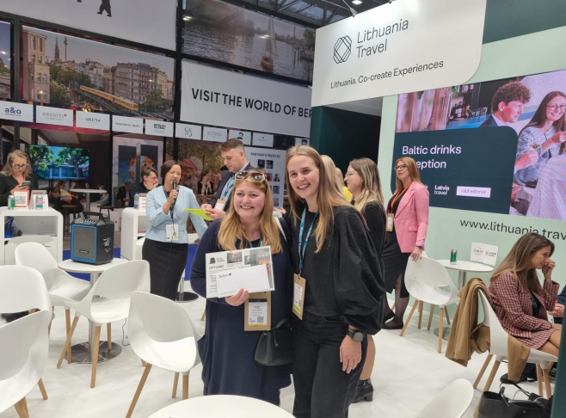

Activity 2.3
Estonian-Latvian nature tourism product presentation at travel markets
World Travel Market London 2024
From November 5th to 7th, representatives from the Baltic Nature Tourism project were active participants at the "World Travel Market London" tourism exhibition, which attracted visitors and exhibitors from all over the world, with attendance exceeding 40,000. The stand was shared with other companies, organized by Latvian Tourism Board. After event, a get-together was organized at the Latvian stand for UK tour operators for networking.

Slide 18
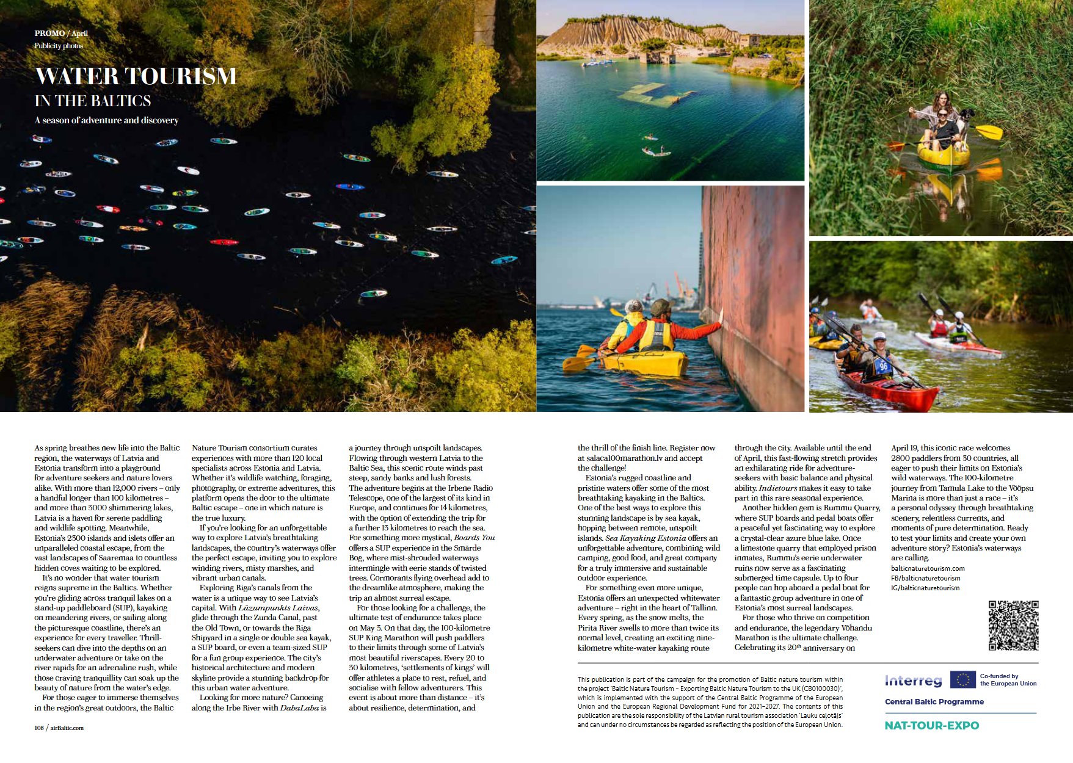
Activity 2.4
Estonian-Latvian nature tourism product presentation to nature organisations in the UK
An advertisement will be put in the April Baltic Outlook (AirBaltic on-board magazine).
Another ad is planned for May's Baltic Outlook, where there will be a greater emphasis on hiking activities.

Slide 19
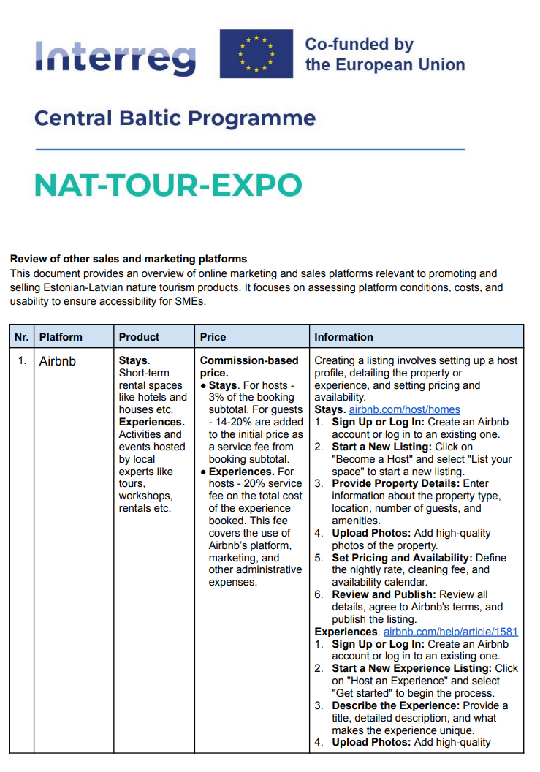
Activity 2.8
Review of other sales and marketing platforms
After a review of the web platforms promoting and offering Baltic nature tourism products, a summary of commercial sales web platforms has been created. It summarises the opportunities, conditions and costs to put a product on such platforms. The info will be distributed to project partners and all project SMEs. The existing platforms and potential additions will be monitored regularly throughout the project and the document / info updated accordingly.
Link: https://www.celotajs.lv/g/Professional/Projects/NAT-TOUR-EXPO/CommunicationPlan/BNT_Review_of_other_sales_and_marketing_platforms.pdf

Slide 20
